Slide 1
Federal Health Information Model* (FHIM) Briefing *Refers to a “suite” of FHIM pertinent products
D R A F T
A Foundation for Healthcare Interoperability (HCI) for
Federal Agencies Engaged in Healthcare
Federal Agencies and External Trading Partners
June 29, 2016
Notes:
This slide deck is a briefing on the Federal Health Information Model (FHIM) and its current and recommended future use by the Department of Veterans Affairs. The target audience for this deck is VA/VHA leadership familiar with issues of healthcare information, terminology, standards, interoperability, and pertinent laws, regulations, and policies (LRP).
The FHIM is published on the public GitHub software collaboration website, and is maintained by the Federal Health Architecture (FHA) E-Gov Line of Business Initiative. The Department of Health and Human Services is the FHA Managing Partner. The Department of Defense, Department of Veterans Affairs, and Social Security Administration are FHA Lead Partners. Additionally there are over 30 FHA Participating Agencies.
Please note that in the context of this briefing the term FHIM refers not only to an information model, but to a suite of FHIM-pertinent products. You may also want to be aware that the FHA FHIM modeling team is collaborating with the HL7 Clinical Information Modeling Initiative (CIMI) to potentially create a consolidated healthcare and clinical information model that would be international in scope. There would also be a U.S. realm version of the model and a federal sub-realm version. One name that has been put forth for this consolidated model is the "Common Health Information Model" (CHIM).
Finally please note that for this briefing the acronym HCI is used to mean healthcare interoperability. See the backup slides for the rationale for this.

Slide 2
Overview: 28 Slides + Conversation
Introduction
Context: Situational Awareness
Context: Hypothesis
Context: Imperatives that Follow
Achieving Seamless HCI
Desired End-State: Seamless Healthcare Interoperability (HCI)
Achieving the Desired HCI End-State
Step 1: Reconcile HCI Requirements Across Partners
Step 2: Specify Combined Business plus Technical HCI Requirements
Step 3: Build HCI Solution Components
Step 4: Deploy HCI Solution into Production
Game Changer
Interoperability Regardless of Paradigm
Complete Support of HCI Requirements
Nuts & Bolts
FHIM “Product Suite”
The FHIM Information Model
The FHIM Terminology Model
FHIM Current State Domains
FHIM Implementation Bundle Components
Business Case
Automated HCI Solution Development
FHIM Uses by Federal Agencies: 1 – 6
FHIM Uses by Federal Agencies: 7 – 12
Recommended Path Forward
FHIM VA/VHA Current and Future Usage
Questions / Discussion
Notes:
Slide 1: "Overview: 28 Slides + Conversation"
[With each new slide first say: "Slide n: + <slide title>“ ]

Slide 3
Situational Awareness – FHIM Evaluation
Unfortunately among federal healthcare agency leaders, for a variety of reasons, there has been an ebb and flow in the perceived value of the FHIM since its inception in 2010. Recent healthcare industry excitement over the new HL7 Fast Health Interoperability Resources (FHIR) standard, resulted in reduced leadership endorsement of the FHIM to the point that in 2014 and 2015 some were questioning its utility. As a result, two separate assessments of the FHIM were organized, one in 2015 conducted by the Open Group, and one conducted by Federal Health Architecture (FHA) consultants, the FHA FHIM team, and representatives from FHA federal partner agencies. The results of the FHIM Evaluation project report are were briefed by the FHA Director in mid-June.*
*Business Architecture HIT Strategic Insight Report – FHIM Evaluation
Notes:
This slide provides some history on the ebb and flow of the FHIM program since its inception in 2010, including the 2015 Open Group evaluation of the FHIM, and the recent FHA peer evaluation of the FHIM, the results of which were briefed by the FHA Director on June 13.

Slide 4
Situational Awareness – HCI Standards Convergence
Meanwhile, work on the FHIM has continued and it appears to have reached a tipping point, being recognized by thought leaders, and SDOs such as HL7, as a potential foundation for achieving the industry vision of broad and seamless HIT interoperability. There are other HIT interoperability standards that are also part of this story including FHIR, CIMI, C-CDA, and SOLOR. The benefactors of this convergence of standards will be such VA/VHA initiatives as Care in the Community, the Electronic Health Management Platform (eHMP), and the Digital Health Platform.*
*Business Architecture HIT Strategic Insight Report – FHIM Evaluation
Notes:
This slide speaks to the optimistic future of the FHIM.

Slide 5
Hypothesis
Background: The FHIM is the most mature, comprehensive, and robust healthcare information model that we know of. The FHIM is supplemented with industry standard open source tooling including UML 2 Modeling, Eclipse plug-ins, Model-Driven Health Tools (MDHT), Model Driven Message Interoperability (MDMI), and (potentially) Model-Driven Software Development (MDSD).
Hypothesis: By supporting and leveraging the FHIM "product suite” VA/VHA will meet pressing HCI requirements the most quickly and effectively.
Notes:
Please read the Background bullet. [Count to 10 ] By "most mature" we mean exceptional in terms of quality and quantity of business and technical SME input and review, representing diverse stakeholders. By comprehensive we mean exceptional in terms of breadth of information domain coverage. By "robust" we mean exceptional in terms of depth – e.g. including terminology system bindings and coded value sets.
Now for the Hypothesis: By strongly supporting and leveraging the FHIM "product suite", VA/VHA can achieve healthcare interoperability solutions that are more timely, economical, automated, repeatable, standardized, controlled, and agile.

Slide 6
Imperatives that Follow
The FHIM architecture and “product suite” must be validated, documented, communicated, and further tested and proven. FHIM team staffing must be augmented to meet VA/VHA’s pressing HCI requirements as well as the pressing requirements of other federal agencies and partners. A version of the FHIM must be provided to the healthcare industry to help bring more objectivity, coherence, practicality, and architectural gravitas to the current disparate HCI landscape.
Notes:
Take a moment to read this. [Count to 10 ] For the FHIM to reach it’s full potential these things must happen.

Slide 7
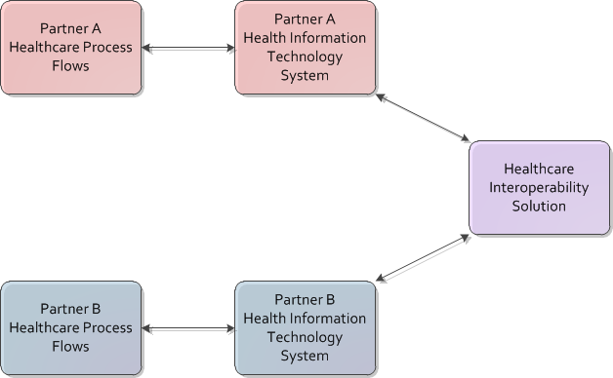
Desired End-State: Seamless Healthcare Interoperability (HCI)
Notes:
This diagram represents the desired healthcare interoperability (HCI) end-state between any number of trading partners, but as shown here just two partners, A and B. As part of their normal clinical and administrative process flows, each partner interacts with its healthcare IT (HIT) system. Some of these interactions involve interoperability with the HIT system of the other partner. The HIT systems involved, seamlessly, accurately, and securely exchange the necessary information, and the clinical and business processes flow smoothly and as expected. Note: In this presentation the term "HIT system" may in fact refer to a "system of HIT systems".

Slide 8
Definition: FHIM Product Suite, Components for Building HCI Solutions
Includes the most robust information model available that we know of for healthcare interoperability
Includes the most robust terminology model available that we know of for healthcare information exchange
Code system bindings
Explicit coded value sets
Includes tooling to specify interoperability requirements, and to automatically generate requisite solution product bundles
Includes tooling to transform information between different HCI implementation paradigms and versions
Notes:
The "FHIM product suite" includes a robust information model, a terminology model, and a set of standards-based open source tooling to manage and automate interoperability implementation. This includes tooling for working with and visualizing models, for automatically generating implementation components, for automatically generating implementation guides, for standardizing data across disparate interoperability paradigms (e.g. FHIR or HL7 v2), and for run-time data mapping and transformation between these paradigms.

Slide 9
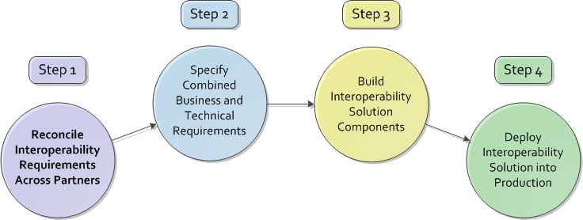
Achieving the Desired HCI End-State
Notes:
For this briefing we have broken down the path to achieving the desired healthcare interoperability end-state into four steps. In Step 1 each trading partner defines, for one or more process flows, its interoperability requirements, and then reconciles these requirements with the other partner. In Step 2 each partner specifies its overall combined business plus technical interoperability requirements. Note: Each partner will likely have already chosen and be using a different interoperability paradigm or a different version/interpretation of the same paradigm. In Step 3 each partner builds its necessary interoperability solution components, which include an implementation guide and FHIM data mapping. In Step 4, the final step, the partners deploy their interoperability solutions into production, which includes use of a shared data element mapping runtime engine.
Note: In the five slides that follow we are showing only two trading partners – but the concepts presented apply to an unlimited number of partners. Also we are assuming that the two partners have identified a brand new set of interoperability requirements. More typically partners would be extending existing interoperability, rather than starting from scratch.

Slide 10

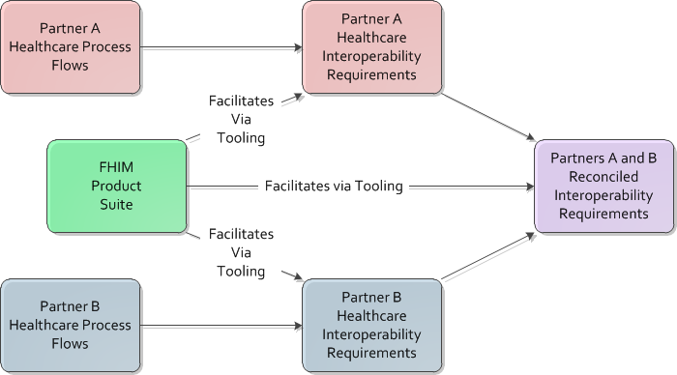
Step 1: Reconcile HCI Requirements Across Partners
Notes:
In this step partners A and B analyze their healthcare process flows, and define their respective healthcare interoperability requirements. They then reconcile these requirements, filling in any gaps, and resolving any incongruities. The FHIM information model, terminology model, and tooling, facilitate this requirements definition and reconciliation activity. A FHIM product suite capability called Model-Driven Health Tools (MDHT) automates and accurizes the process. Note that MDHT is industry standard open source software.

Slide 11
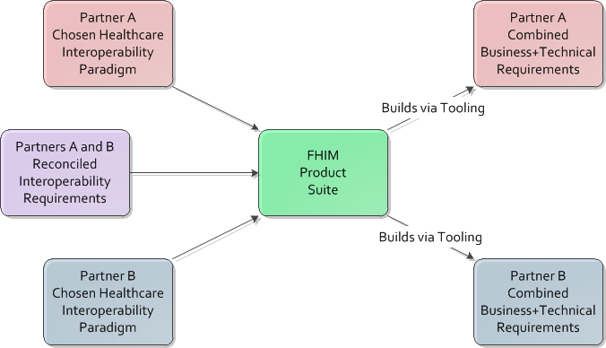
Step 2: Specify Combined Business plus Technical HCI Requirements
Notes:
Most likely partners A and B have already chosen and are using different interoperability paradigms or different versions/interpretations of the same paradigm. Partner A may be using HL7 v2.5 while partner B may plan to use FHIR v2.1. Partner A needs an interoperability specification that covers both its business requirements plus its technical requirements. The same is true for partner B. As shown in this slide, the FHIM product suite is used by each partner to automate and accurize development of its combined business plus technical interoperability requirements specifications.

Slide 12
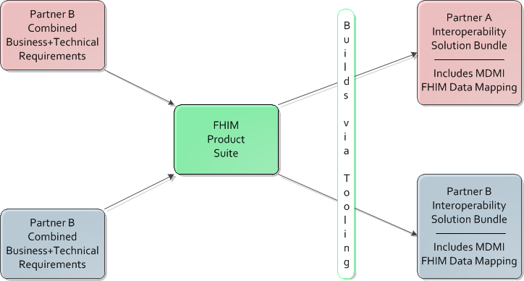
Step 3: Build HCI Solution Components
Notes:
In this step each partner transforms its specifications into a set of interoperability solution components. Again each partner uses the FHIM product suite, and MDHT in particular, to automate and accurize the building of all outward facing components. These include a solution implementation guide, interface software, testing harness, schematrons, test messages, and FHIM data mappings. A FHIM product suite capability called Model-Driven Message Interoperability (MDMI) is used to generate data mappings between the respective interoperability paradigms of the two partners.

Slide 13
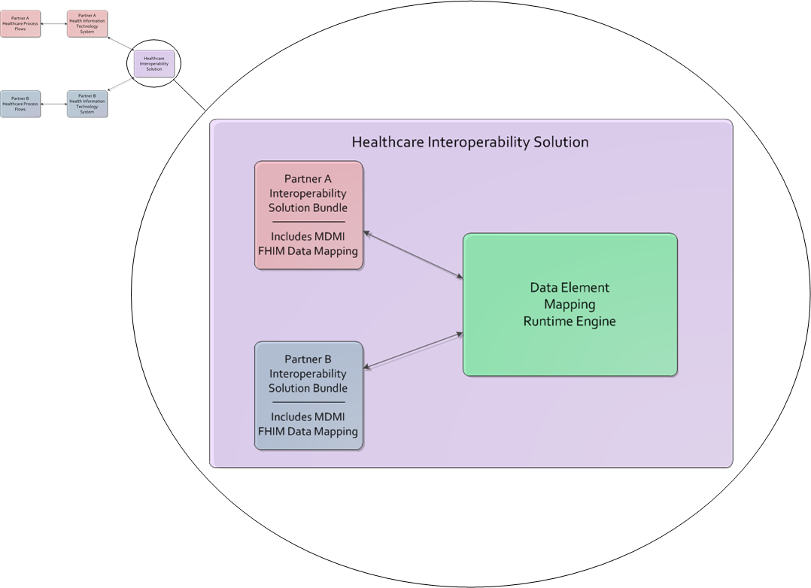
Step 4: Deploying HCI Solution into Production
Notes:
This slide again shows the desired interoperability end-state, miniaturized at the upper left, but with the healthcare interoperability solution magnified, showing more details of that solution. The two partners have tested and implemented their part of the interoperability solution. The healthcare interoperability solution between them includes their respective solution bundles, and an additional component of the FHIM product suite which is the MDMI data element mapping runtime engine. Note that MDMI supports both simple data element to data element mapping, and complex data element transformation. Like MDHT, MDMI is industry standard open source software.

Slide 14
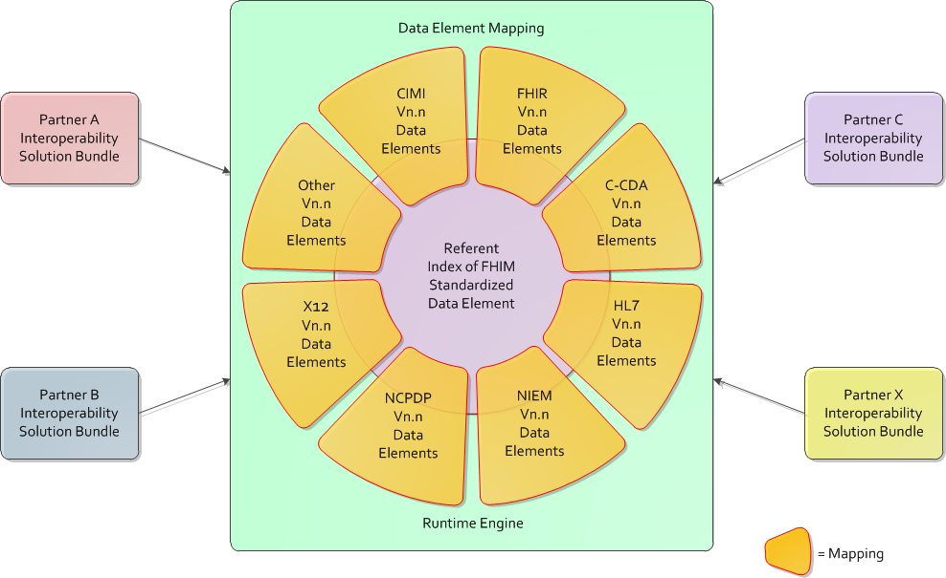
Interoperability Regardless of Implementation Paradigm Used by Each Partner
Notes:
The data element mapping runtime engine is implemented using the previously mentioned MDMI software. MDMI is a mature standard, used extensively in the banking industry, but gaining significant traction in the healthcare industry. In MDMI jargon, as shown here, there is a data element mapping for each HCI paradigm. There is also a referent index of FHIM standardized data elements. MDMI includes tooling that facilitates creation and maintenance of the mappings, and creation and maintenance of as needed data element transformations. As show here, the FHIM mediates data element mapping between any combination of HCI paradigms and versions.

Slide 15
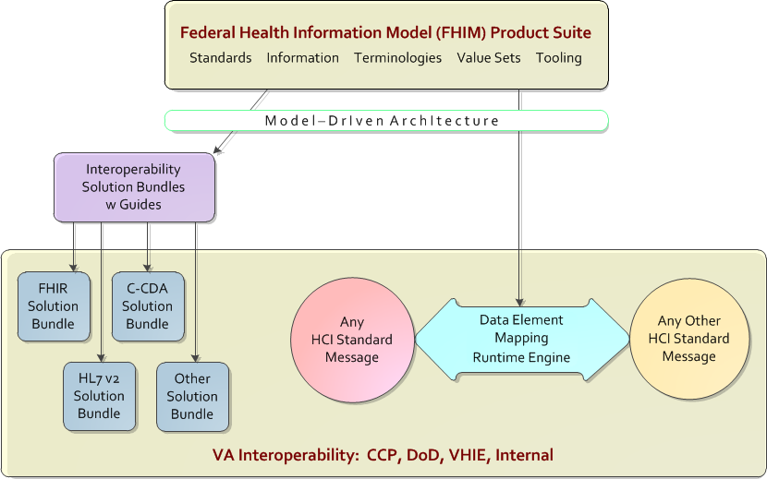
Complete Support of Healthcare Community Interoperability Requirements
Notes:
This slide shows that the FHIM product suite is designed to support a complete range of healthcare interoperability requirements. Leveraging the OMG Model-Driven Architecture (MDA) standard, the FHIM product suite provides the capability to generate complete, accurate, and consistent interoperability solutions for FHIR, HL7‑v2, C‑CDA, CDA, CIMI, NIEM, NCPDP, X12, and other HCI paradigms. Potentially any HCI standard message can be transformed into any other HCI standard message.
Note: Obviously not the FHIM nor any other approach on the planet can create data out of thin air that is not supported by a particular HCI standard. So message transformation between standards is not without limitations. At the same time, it should be noted, that most standards do have provisions for extension. In this case the FHIM can help to ensure that extensions are implemented consistently by all stakeholders.

Slide 16
FHIM “Product Suite”
Information Model
Domain Models
Datatypes Model
Common Class Models
Terminology Model
Per Attribute
Coding System Binding
Coded Value Sets
Maintained in NLM VSAC
Usage Guidelines
Information Modeling
Terminology Modeling
Implementation Process
Tooling
UML 2
Rational RSA or SPARX EA
Eclipse plug-ins and MDSD
Model-Driven Health Tools (MDHT)
Model-Driven Message Interoperability (MDMI)
Notes:
[NLM VSAC: Value Set Authority Center ]

Slide 17
The FHIM Information Model
UML-based logical (platform independent) information model of exceptional breadth and depth
The most robust reference information model available the we know of for HCI
Developed collaboratively over six years with numerous federal agency experts
Harmonized with all significant SDO initiatives such as FHIR, C-CDA, CIMI, SNOMED, LOINC, etc.
Continuously updated as HCI standards are refined and new HCI requirements are identified
Potentially: Authoritative for Federal HCI, and recommended for all user facing APIs and services
Notes:
[Read bullets ]

Slide 18
The FHIM Terminology Model
Includes every coded attribute of the FHIM information model
(As indicated in the FHIM Current State table that follows)
Associated with each attribute is a coding system
Associated with each attribute is an all-inclusive value set
FHIM value sets are maintained using the NLM VSAC (Value Set Authority Center)
Notes:
Note: All-inclusive value set means every value that we think would be used for any use case involving that attribute. Of course there will be cases where value set subsets must be determined.

Slide 19
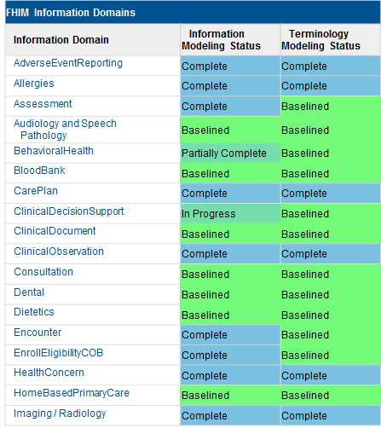
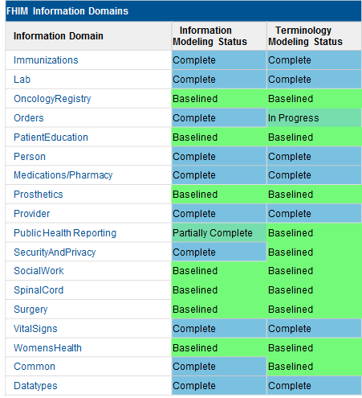
FHIM Current State Domains are being completed by priority of usage
Notes:
Note: Due to the limited resources of the FHIM team, some completed information domains may not be fully up-to-date. The VHA Business Information Architecture (BIA) unit helps to keep FHIM domain models up-to-date in two ways.
The first way is that BIA uses the FHIM as a starting point for modeling a new subject area. Once both the subject area processes and information have been modeled and signed off on by SMEs, BIA then recommends updates of the FHIM. The second way is that BIA participates in reviews of a new or updated FHIM domain model, and recommends refinements based on comparison to the corresponding domain of the VHA Business Information Model (BIM).

Slide 20
FHIM Implementation Bundle Components
HCI Requirements (Use Case) Implementation Guide
Interface software
Testing harness
Schematrons
Test messages
FHIM data mappings
As needed Referent Index entries
Notes:
If asked: Schematron is a rule-based validation language using XPath expressions for making assertions about the presence or absence of patterns in XML trees. A schematron is an implementation component written in the Schematron language.

Slide 21
Automated HCI Solution Development
Prima facie, automated is Faster, Cheaper, and Repeatable
Turbulence throughout the healthcare industry is driving
Changing and maturing interoperability requirements
Changing and maturing interoperability standards
Faster → More timely delivery of HIT solutions that involve HCI
Cheaper → More affordable HIT solutions that involve HCI
Repeatable → More rapid adaption when changes occur in HCI requirements and standards
Notes:
Prima facie is pronounced: Prim-uh fay-she
FHIR is a case in point
Maturity is a matter of controversy
Still a DSTU
First normative ballot has been delayed another 4 months
Requires “hand crafting” (profiles and extensions) to be implementable
There is a proliferation of discordant implementations
Via FHIM, conflicting FHIR profiles can be normalized to achieve required HCI

Slide 22
FHIM Usage by Federal Agencies 1 – 6: The FHIM serves as a
Single point of reference for synchronization of federal healthcare information activities and for cross-agency collaboration
Single reference source on federal healthcare information laws, regulations, policies, and standards
Foundation for healthcare information semantic consistency supporting analytics, quality improvement, and decision support
Information reference model for intra-agency, inter-agency, and healthcare industry interoperability
Foundational component for automated, repeatable, and accurate generation of healthcare interoperability solutions
Trusted, truth-driven, non-proprietary knowledge source about healthcare information
Notes:
There are numerous examples of how the FHIM is being leveraged, and where agency plans are, or should be, leveraging the FHIM in the future. Here are six uses that are some of the most compelling.

Slide 23
FHIM Usage by Federal Agencies 7 – 12: The FHIM serves as a
Collection point for continuous accumulation of knowledge about healthcare information
Focal point for import and export of healthcare information knowledge from and to the overall healthcare industry
Comprehensive and mature jumping off point for federal healthcare information-intensive projects
Comprehensive and mature jumping off point for federal agency healthcare enterprise conceptual and logical information models
Comprehensive and mature jumping off point for corresponding US realm and global healthcare information models
Reference source to reduce the likelihood of one-off federal healthcare information solutions for the sake of expediency
Notes:
Here are another half dozen examples of uses of the FHIM.

Slide 24
FHIM Usage at VA/VHA Current State
Informs the VHA Business Information Model (BIM)
Ensures VA work remains synchronized with other federal agencies whose data modelers also reference the FHIM
Is referenced prior to any new VHA information modeling activity
Is extended by the VA as necessary
Extensions are communicated back to FHA for inclusion
VA health segment information modeling is represented in the BIM which leverages and strives to coordinate its content with the FHIM!

Slide 25
FHIM Usage at VA/VHA Transition State
Serves as the authoritative federal health reference model, that informs the VHA enterprise information model (BIM) and ensures VA cross agency health information alignment
The BIM/FHIM provide a comprehensive health business information model for VA, and inform leadership decision making, HIT requirements definition, and HIT messaging, interoperability, protection and management.
The future state VA Virtual Patient Record will provide an extensive FHIR API, profiled and extended using the FHIM/BIM and automated tooling, and supporting advanced clinical user interfaces, 3rd party apps, and clinical interoperability.

Slide 26
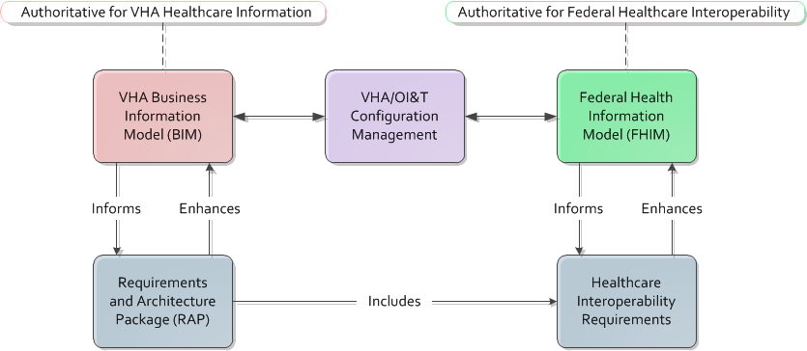
FHIM Usage at VA/VHA – Future State Interoperability Requirements Definition
Notes:
The scope of the Requirements and Architecture Package (RAP) can be focused on a specific work effort such as the Provider Profile Management System, or on a broad initiative such a the Virtual Patient Record (VPR).

Slide 27
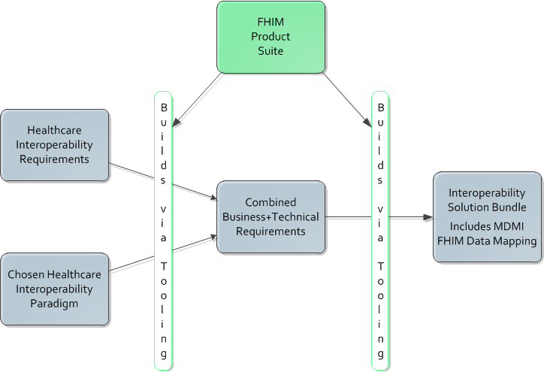
FHIM Usage at VA/VHA – Future State Interoperability Solution Generation

Slide 28
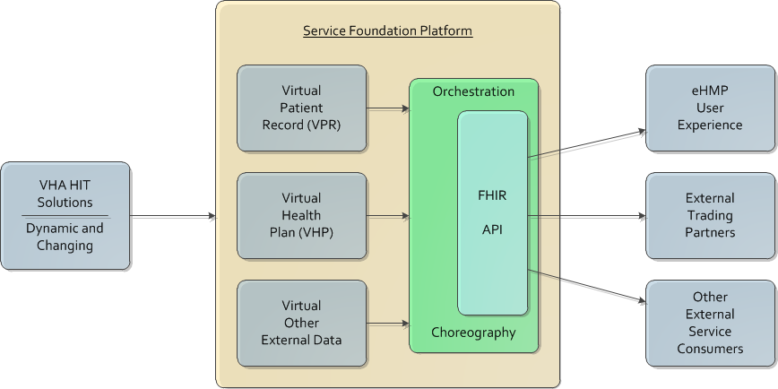
FHIM Usage at VA/VHA – Future State Notional Service / Interoperability Paradigm

Slide 29
Hypothesis – Revisited
Background: The FHIM is the most mature, comprehensive, and robust healthcare information model that we know of. The FHIM is supplemented with industry standard open source tooling including UML 2 Modeling, Eclipse plug-ins, Model-Driven Health Tools (MDHT), Model Driven Message Interoperability (MDMI), and (potentially) Model-Driven Software Development (MDSD).
Hypothesis: By supporting and leveraging the FHIM "product suite" VA/VHA will meet pressing HCI requirements the most quickly and effectively.

Slide 30
Recommended Path Forward
Complete “FHIM Evaluation” and brief FHA Boards
FHA Managing Board to be briefed June 13
FHA Council to be briefed July 13
Conduct FHIM “Architectural Summit” to reach consensus and buy-in
May be incorporated as part of HIEA* Technical Forum August 17-18
Prepare FHIM Roadmap and brief to FHA Boards
May be part of lead-up to HIEA Technical Forum and part of follow-up
Organize FHIM-CIMI* “full court press”
Note “FHIM-CIMI Task Force”
* HIEA: Health Interoperability and Exchange Alliance
* CIMI: Clinical Information Modeling Initiative (HL7)

Slide 31

FHIM Briefing
Questions - Discussion
30
Notes:
30

Slide 32
FHIM Briefing
Backup Slides
31
Notes:
31

Slide 33
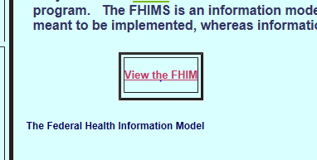
FHIM Web Site
http://www.fhims.org
Click “View the FHIM” to see and navigate the model. You may have to wait for 30 seconds or so for the Diagram and Model navigator on the left side to populate. Then it’s very snappy. Play around to get the hang of it. Use your browser to zoom in and zoom out.
32
Notes:
32

Slide 34
Placeholder for MDHT Overview Briefing (Model Driven Health Tools)
33
Notes:
33

Slide 35
Placeholder for MDMI Overview Briefing (Model Driven Message Interoperability)
34
Notes:
34

Slide 36
NLM Value Set Authority Center (VSAC)
https://vsac.nlm.nih.gov
35
Notes:
35

Slide 37
Notes on the term “Healthcare Interoperability” and the abbreviation “HCI”
Why the term Healthcare Interoperability?
The term is broadly used throughout the healthcare industry
More so than Health Interoperability
More so than Healthcare Information Interoperability
Note, however, that the term Health Information Exchange is a far more broadly used term than Healthcare Interoperability – but
Health Information Exchange has several distinct meanings which can lead to confusion
Health Information Exchange connotes a lesser degree of cross-organizational integration than Healthcare Interoperability
Why the abbreviation HCI versus simply HI?
Because HI also stands for Health Informatics which can be confusing in the context of discussing the FHIM
And HCI is a fairly common abbreviation for Healthcare Interoperability
Why Healthcare Interoperability versus Health Interoperability?
Healthcare Interoperability is the more commonly used term (as previously noted)
Health Interoperability would logically be abbreviated HI and therefore be confused with the abbreviation for Health Informatics
Healthcare Interoperability better connotes both administrative as well as clinical interoperability, which is more appropriate in the context of discussing the FHIM

Slide 38
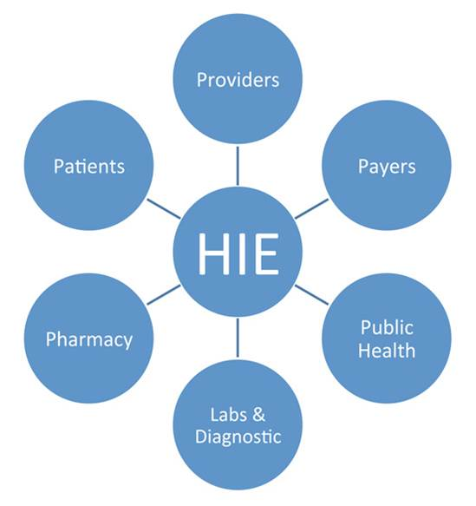
AHMIA Representation of a Health Information Exchange

